Slide 1
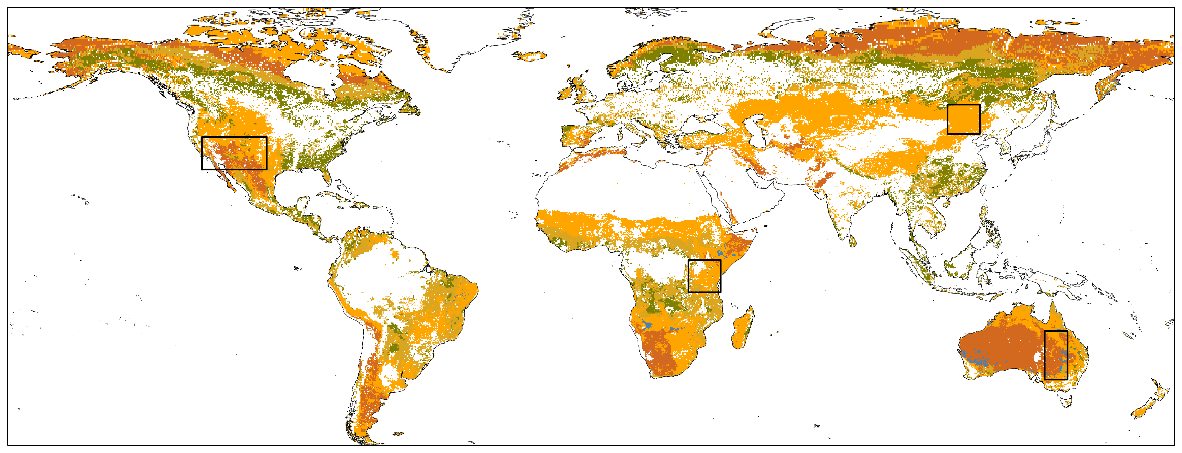
CSH
OSH
WSA
SAV
GRA

Slide 2
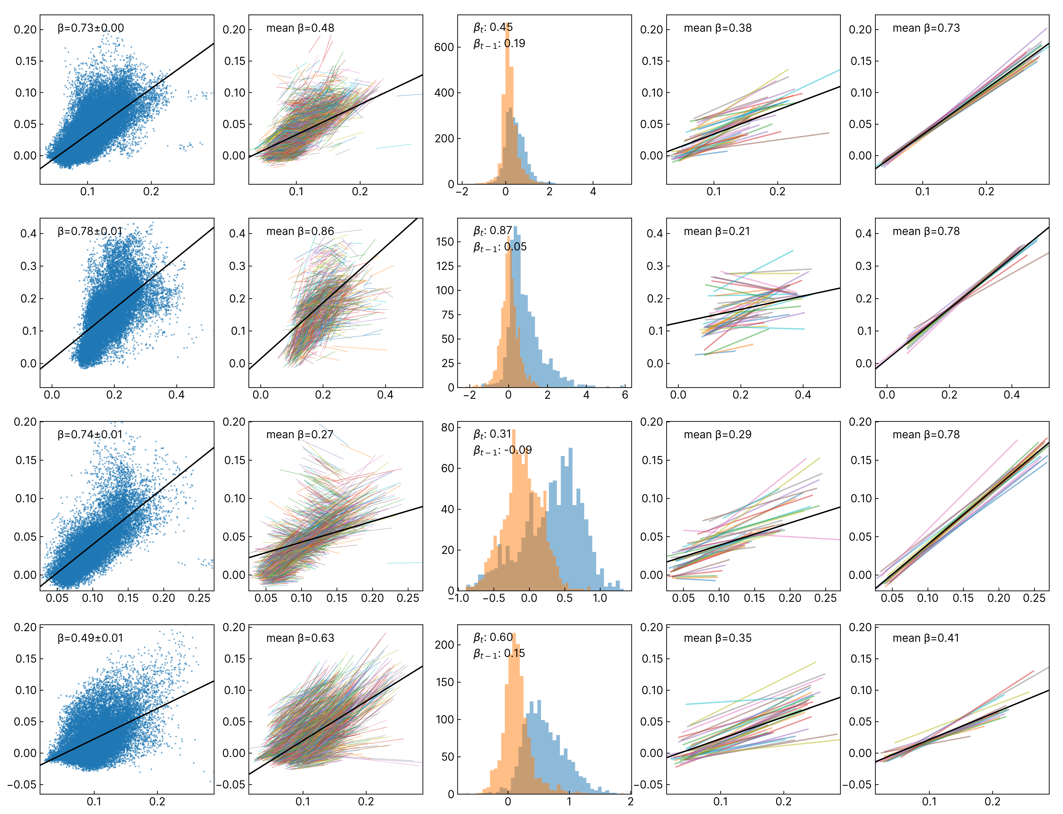
No confounder
Temporally-Invariant Unknown Confounder
Temporally-Invariant Confounder with Temporally Lag Causal Effects
Temporally-Invariant Unknown Confounder + Observed Confounder
Spatially-Invariant
Unknown Confounder
H
H
AI
H
s
s
S
s
t
S
G
S
G
S
G
S
G
S
G
US Southwest
Serengeti
Mongolian Steppe
Australian Inland

Slide 3
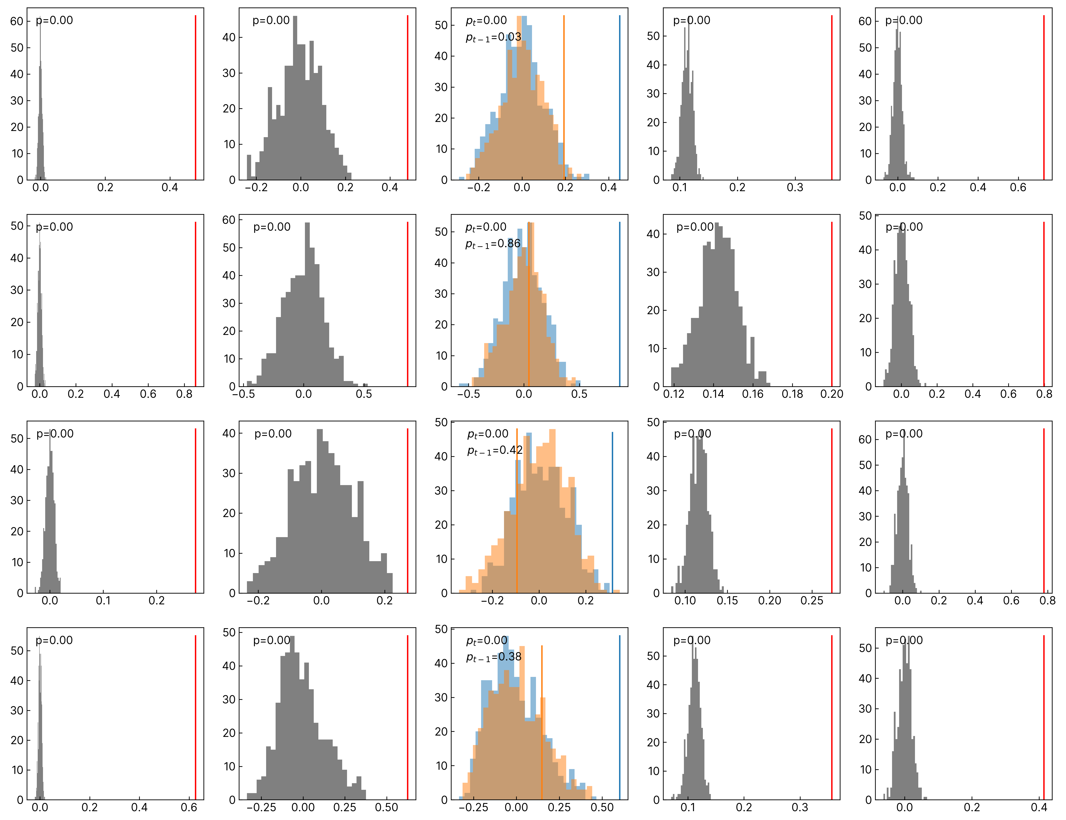
No confounder
Temporally-Invariant Unknown Confounder
Temporally-Invariant Confounder with Temporally Lag Causal Effects
Temporally-Invariant Unknown Confounder + Observed Confounder
Spatially-Invariant
Unknown Confounder
H
H
AI
H
s
s
S
s
t
S
G
S
G
S
G
S
G
S
G
US Southwest
Serengeti
Mongolian Steppe
Australian Inland

